Slide 1

DocInsight AI: An Intelligent Document Analysis and Question Answering System
A CAPSTONE PROJECT
COURSE : DSA0306 NATURAL LANGUAGE PROCESSING
Presented by:
Aswanth NN 192424123
Vasantha Nithi D Y 192424137
G Aswartha Manidheep 192425089
Mohammed Jameel A 192425057
Guided By
Dr. Kumaragurubaran T

Slide 2
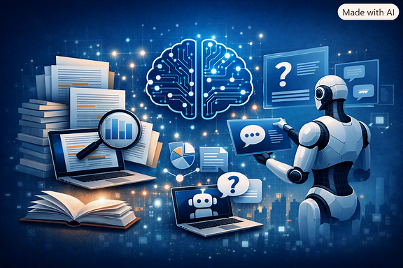
INTRODUCTION
DocInsight AI is an intelligent document analysis system that uses Artificial Intelligence (AI) and Natural Language Processing (NLP) to process and understand documents.
It supports multiple document formats such as PDF, Word (DOCX), and scanned images (JPG/PNG).
The system extracts text from scanned documents using Optical Character Recognition (OCR), making non-editable documents searchable.
It generates summaries, extracts key insights, and enables semantic search to help users quickly locate relevant information.
Users can ask questions in natural language, and the system provides accurate answers based on the uploaded document using Retrieval-Augmented Generation (RAG).

Slide 3
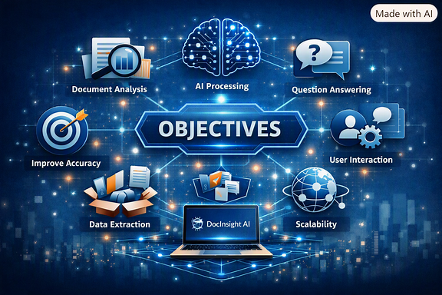
OBJECTIVES
Develop an intelligent system that automatically extracts text from digital and scanned documents.
Reduce the time required to read and understand lengthy documents by generating concise summaries.
Enable semantic search that retrieves information based on meaning rather than exact keywords.
Provide accurate context-aware answers by combining document retrieval with Large Language Models (LLMs).
Improve document accessibility through language translation and text simplification for diverse users.

Slide 4
PROBLEM STATEMENT
Organizations and students often deal with large volumes of documents that require significant time to read and analyze.
Scanned documents cannot be searched directly without OCR, making information retrieval difficult.
Traditional keyword-based search frequently fails to identify relevant content when different wording is used.
Manual document summarization is time-consuming and may overlook important information.
Existing systems generally lack integrated features such as OCR, semantic search, AI-based question answering, and multilingual support.

Slide 5
EXISTING SYSTEM
Existing document tools provide features such as viewing, OCR, summarization, document chat, and search, but capabilities vary across platforms.
Traditional PDF readers primarily focus on document viewing and keyword-based search.
OCR tools mainly perform text extraction rather than complete document intelligence.
Advanced AI document platforms provide features such as summarization and document question answering, but may be proprietary or platform-specific.
Our project integrates OCR, NLP, semantic search, RAG-based Q&A, translation, and simplification into one academic prototype.
Examples: Adobe Acrobat AI Assistant | Google NotebookLM | Microsoft Copilot | ChatGPT

Slide 6
PROPOSED SYSTEM
It uses Optical Character Recognition (OCR) to extract text from scanned documents and images.
Applies Natural Language Processing (NLP) techniques to generate summaries and extract important insights.
Implements Semantic Search using sentence embeddings and vector databases to improve information retrieval.
Integrates Retrieval-Augmented Generation (RAG) with Large Language Models (LLMs) for context-aware question answering.
Supports language translation and text simplification to enhance accessibility and user understanding.
Upload → Text Extraction/OCR → NLP → Chunking → Embeddings → Vector DB → Semantic Search → RAG → LLM → Answer

Slide 7
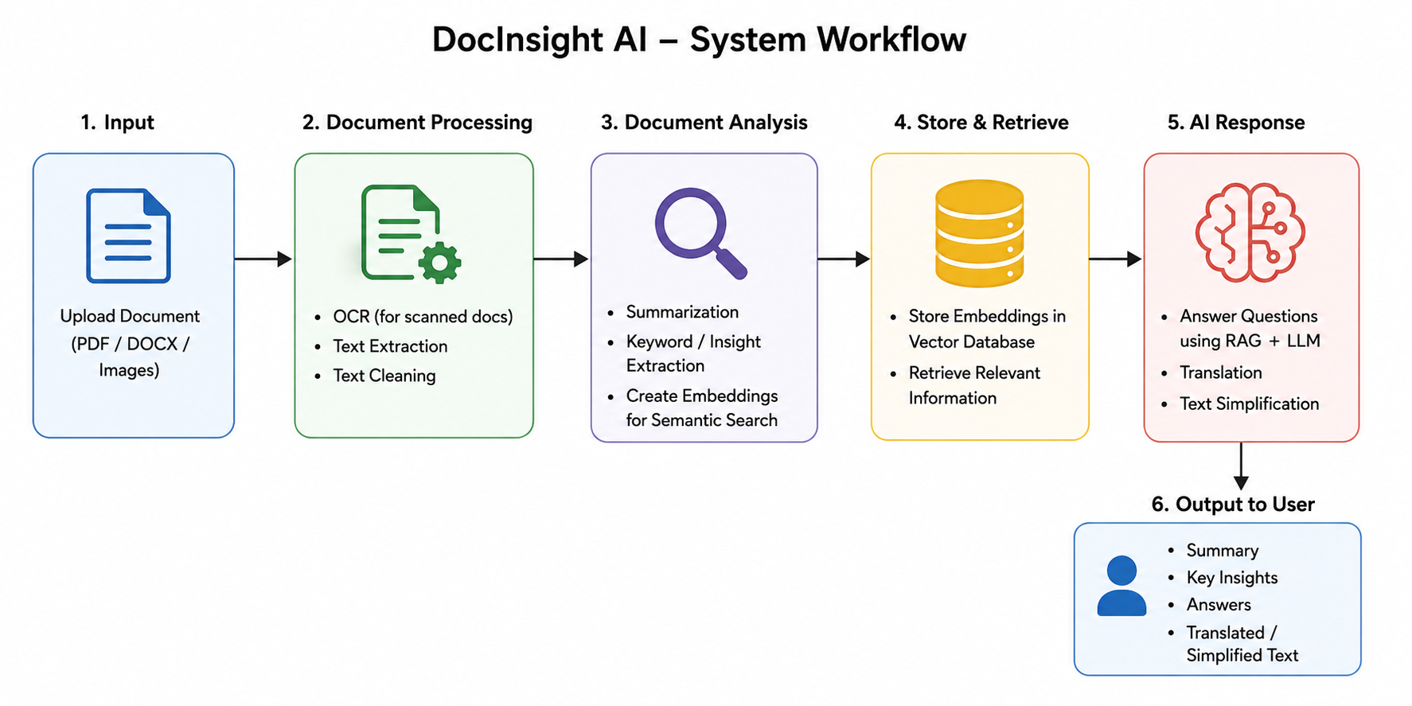

Slide 8
Module 1 – Intelligent Document Processing
Accept and validate uploaded documents (PDF, DOCX, JPG, PNG).
Extract text from digital documents using text extraction and from scanned documents using OCR.
Perform image enhancement and text preprocessing for better accuracy.
Clean and organize extracted text into a structured format.
Store processed text for further analysis.
Techniques Used: OCR, Image Preprocessing, Text Cleaning, OpenCV, EasyOCR/Tesseract

Slide 9
Module 2: Document Intelligence & Insight Generation
Generate concise summaries of lengthy documents.
Extract important keywords and key phrases.
Identify entities such as people, organizations, and locations.
Highlight important insights and document topics.
Prepare processed content for semantic search.
Techniques Used: NLP, Text Summarization, Keyword Extraction, Named Entity Recognition (NER), Hugging Face Transformers

Slide 10
Module 3: Semantic Search & Knowledge Retrieval
Convert document text into vector embeddings.
Store embeddings in a vector database for fast retrieval.
Perform semantic search based on the meaning of user queries.
Retrieve and rank the most relevant document sections.
Provide contextual information for the question-answering module.
Techniques Used: Sentence Transformers, Semantic Embeddings, FAISS/ChromaDB, Cosine Similarity

Slide 11
Module 4: AI-Powered Question Answering & Language Assistance
Accept user questions in natural language.
Retrieve relevant document context using RAG.
Generate accurate, context-aware answers using LLMs.
Translate document content into multiple languages.
Simplify complex text for improved readability.
Techniques Used: Retrieval-Augmented Generation (RAG), Large Language Models (GPT/Llama), LangChain, Machine Translation

Slide 12
Results
Successfully processes digital and scanned documents using extraction and OCR.
Generates summaries, keywords, entities, topics, and insights.
Enables semantic search based on document meaning.
Retrieves relevant document content for user queries.
Provides context-aware answers using RAG and LLM.
Supports translation and text simplification for better accessibility.

Slide 13
Conclusion
DocInsight AI provides an integrated approach for document extraction, analysis, search, and question answering.
OCR enables the system to process both digital and scanned documents.
NLP and semantic search help users understand and locate relevant information efficiently.
RAG and LLMs enable context-aware answers based on the uploaded document.
Translation and simplification further improve the accessibility and usability of document information.

Slide 14
THANK YOU

